Slide 1
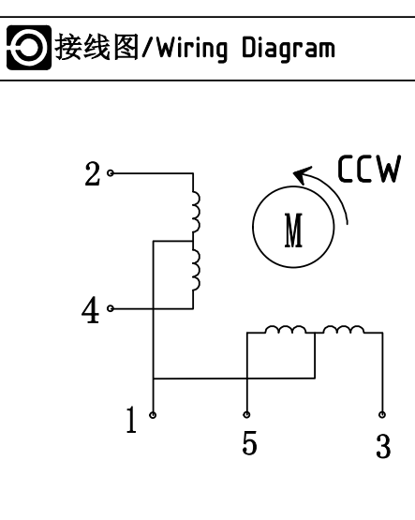
스테핑 모터 사양서 (MS35BYJ46)
Specification
Number of Phase : 4
Basic Step Angle : 7.5 / 85
Reduction Ratio : 1:85
Rated Voltage : 12VDC
Pull in Torque : >=285mN.m
Cogging Torque : 98mN.m
Noise : 45dB
No load pull in frequency >=500Hz
No load pull in out frequency >=800Hz
Wiring Diagram
Phase Sequence (1-2 Phase Exciting)
Terminal Serial Number | Wire Colr | Allocation order CCW ←--------------------------------------------→ CW
 |  | 1 | 2 | 3 | 4 | 5 | 6 | 7 | 8
1 | RED | + | + | + | + | + | + | + | +
2 | ORANGE | - | - |  |  |  |  |  | -
3 | YELLOW |  |  | - | - | -
4 | PINK |  |  |  | - | - | -
5 | BLUE |  |  |  |  |  | - | - | -

